Slide 1
John Grimes
Terminology-Aware Analytics with FHIR

Slide 2
Learning outcomes
Query and analyse a (potentially big) FHIR dataset
Leverage the knowledge within clinical codes by interacting with a FHIR terminology server
GitHub repo: https://github.com/johngrimes/tx-analytics-fhir

Slide 3



Tools

Slide 4
Generate a synthetic patient dataset
Synthea - https://github.com/synthetichealth/synthea
git clone https://github.com/synthetichealth/synthea.git
cd synthea
./run_synthea -p 1000 -s 20191120

Slide 5
Generate a synthetic patient dataset
Aaron697_Lakin515_a254176b-19c8-4269-8f61-36a1cb119b96.json
Abdul218_Stoltenberg489_0d1dfc82-d24c-4bae-be00-c2abea1f6309.json
Abel832_Bernier607_74b76841-0410-4f5e-8034-62740441c870.json
Abel832_Purdy2_2890890f-c542-421e-a5d4-0c8e52007e64.json
Abraham100_Koelpin146_4a3d1b21-66f6-46b3-bf7b-ab8a4916003e.json
Abraham100_Rath779_b7d69fb7-c1ba-471f-b74c-82a31baa0b07.json
Abram53_Mraz590_b69eaeb1-75ce-44c0-8736-6db03d742487.json
...

Slide 6
Get yourself a nice notebook
Docker image: https://hub.docker.com/r/jupyter/all-spark-notebook
Includes:
Jupyter Notebook and JupyterLab
Python and pyspark
R and SparkR
Apache Spark

Slide 7
Transform FHIR into Parquet
Bunsen - https://github.com/cerner/bunsen
from bunsen.r4.bundles import load_from_directory, extract_entry
resources = ['patient',
'observation',
'medicationrequest',
'condition']
bundles = load_from_directory(spark, 'file://path/to/fhir')
for resource in resources:
df = extract_entry(spark, bundles, resource)
df.write.format('parquet') \
.mode('overwrite') \
.save('file://path/to/warehouse/' + resource)

Slide 8
Load data into Spark
warehouse_location = 'file:///path/to/warehouse'
patients = spark.read.parquet(warehouse_location + '/' + 'patient').cache()
observations = spark.read.parquet(warehouse_location + '/' + 'observation').cache()
conditions = spark.read.parquet(warehouse_location + '/' + 'condition').cache()

Slide 9
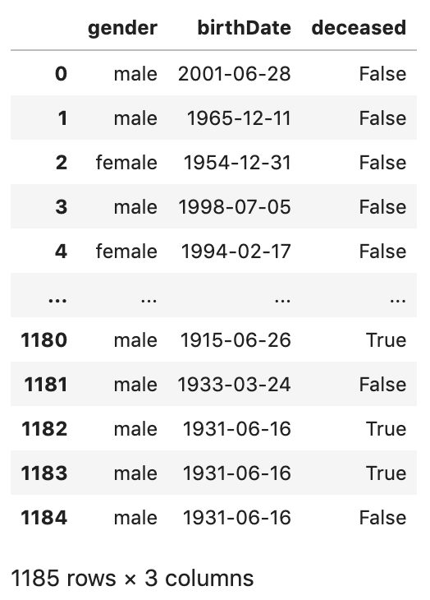
Demographics
demographics = patients.select(
patients.gender,
patients.birthDate,
patients.deceasedDateTime
.isNotNull()
.alias('deceased’)
)
demographics.toPandas()

Slide 10
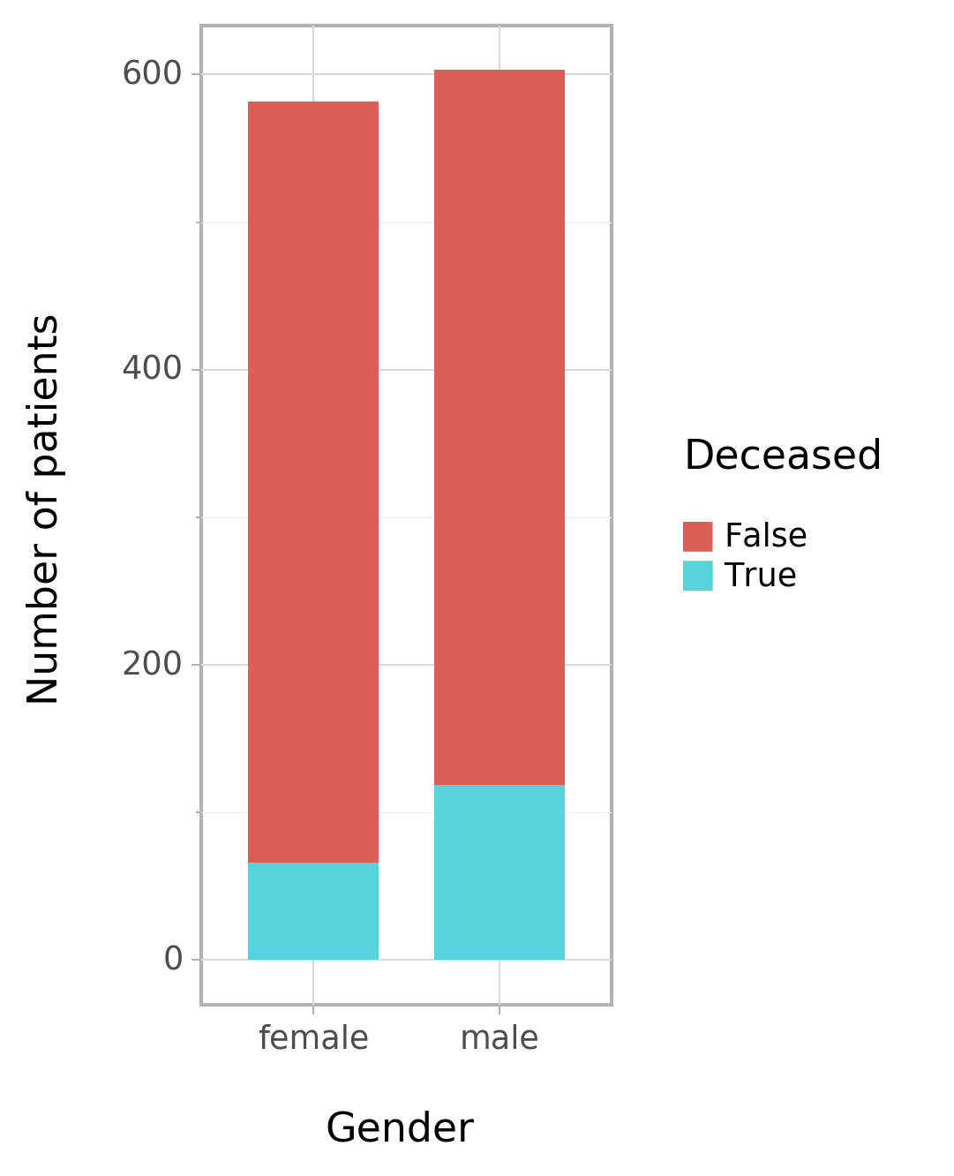
Demographics
from pyspark.sql.functions import count
dems_dataset = patients.select(
patients.gender,
patients.birthDate,
patients.deceasedDateTime
.isNotNull()
.alias('deceased’)
)
dems = dems_dataset.toPandas()

Slide 11
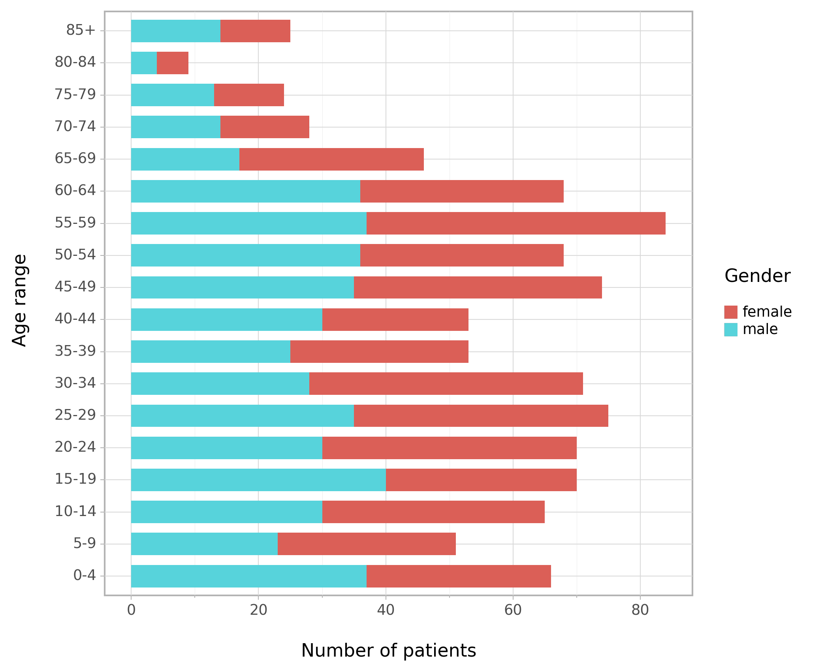
Demographics
Looks legit 👍

Slide 12
Join patients to conditions
from pyspark.sql.functions import expr, explode_outer, countDistinct
report_date = '2019-06-01'
conditions_dataset = patients.join(conditions,
(patients.id == conditions.subject.reference) & \
(conditions.onsetDateTime.isNull() | \
expr("onsetDateTime <= \"%s\"" % report_date)) & \
(conditions.abatementDateTime.isNull() | \
expr("abatementDateTime >= \"%s\"" % report_date)),
'left_outer')

Slide 13
Flattening nested data
conditions_dataset.select(patients.id, conditions.code.coding)
root
|-- id: string (nullable = true)
|-- code.coding: array (nullable = true)
| |-- element: struct (containsNull = true)
| | |-- id: string (nullable = true)
| | |-- system: string (nullable = true)
| | |-- version: string (nullable = true)
| | |-- code: string (nullable = true)
| | |-- display: string (nullable = true)
| | |-- userSelected: boolean (nullable = true)

Slide 14
Flattening nested data
conditions_dataset.select(patients.id,
explode_outer(conditions.code.coding)
.alias('conditionCoding'))
root
|-- id: string (nullable = true)
|-- conditionCoding: struct (nullable = true)
| |-- id: string (nullable = true)
| |-- system: string (nullable = true)
| |-- version: string (nullable = true)
| |-- code: string (nullable = true)
| |-- display: string (nullable = true)
| |-- userSelected: boolean (nullable = true)

Slide 15
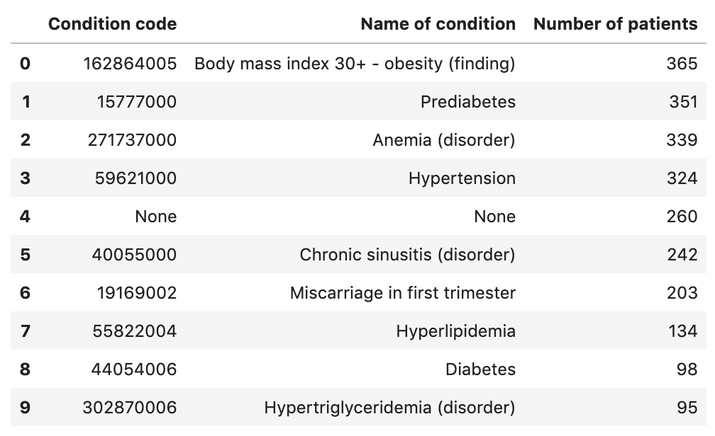
Disease profile
106 distinct SNOMED CT Condition codes
How could we group them?

Slide 16
With ValueSets!
We can define sets of codes that allow us to categorise our data, for the purposes of grouping and filtering
ValueSets can be defined as:
Simple enumeration of codes
Rules that describe the criteria by which codes are included / excluded

Slide 17
SNOMED CT ValueSets
Rich expression language, available through FHIR
Shrimp can help you explore the ontology, and author expressions to define ValueSets
https://ontoserver.csiro.au/shrimp

Slide 18
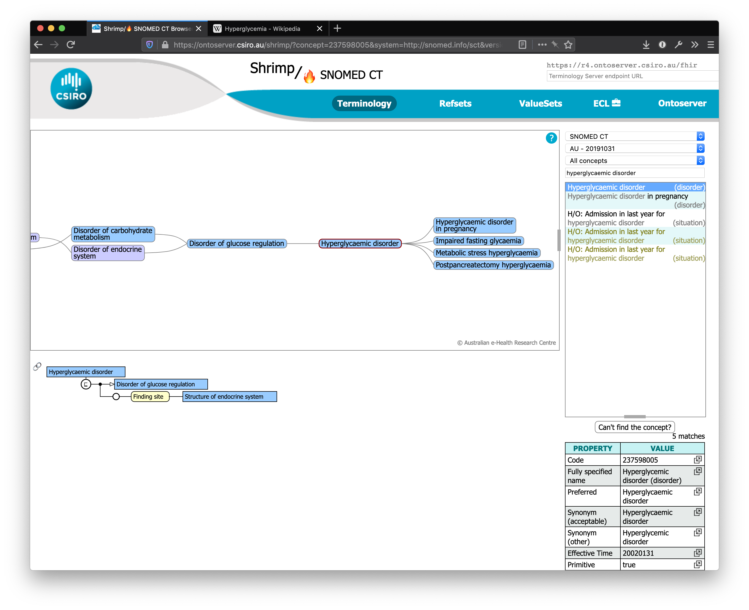

Slide 19
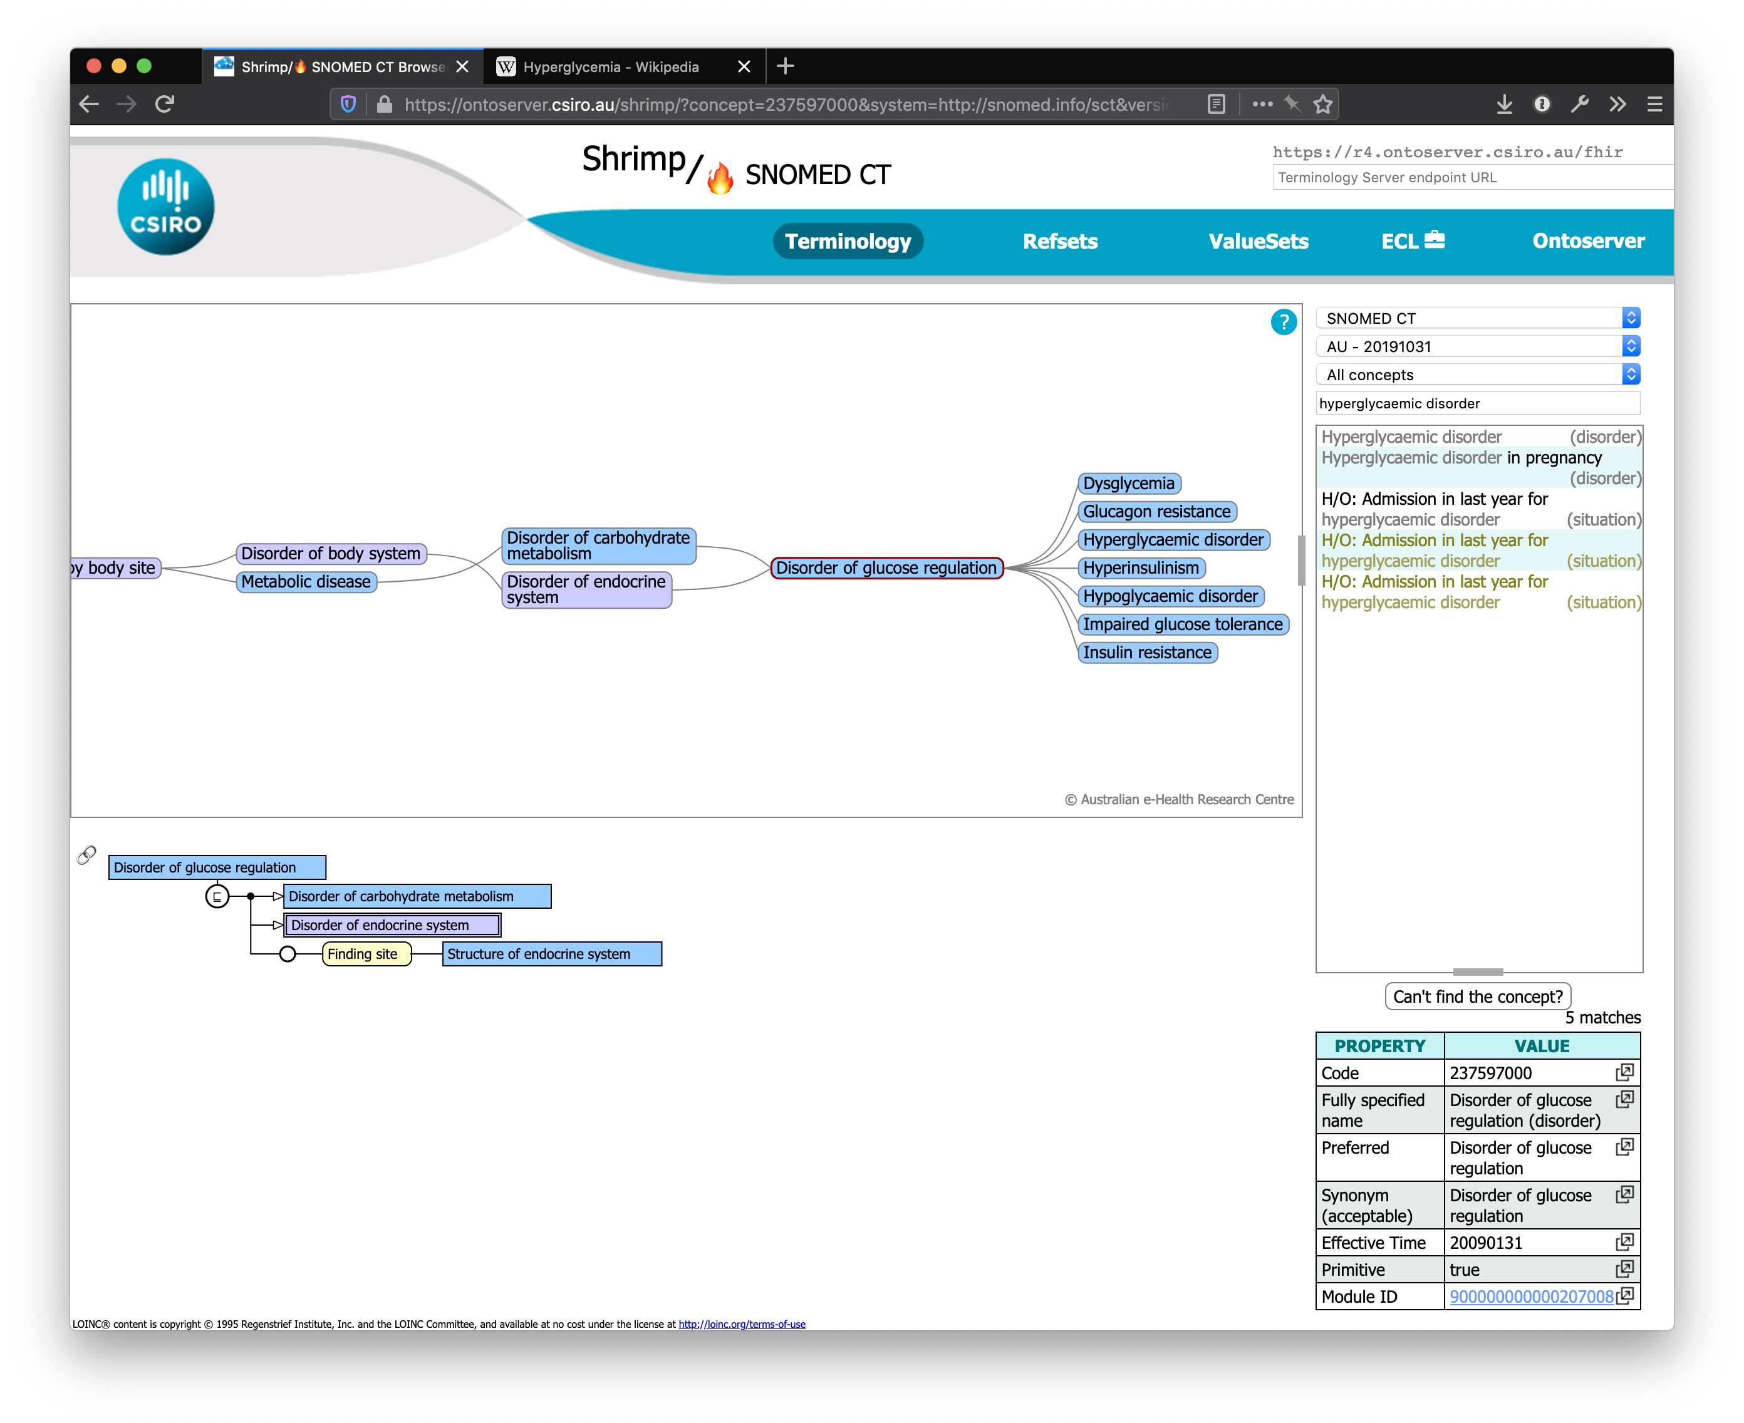

Slide 20
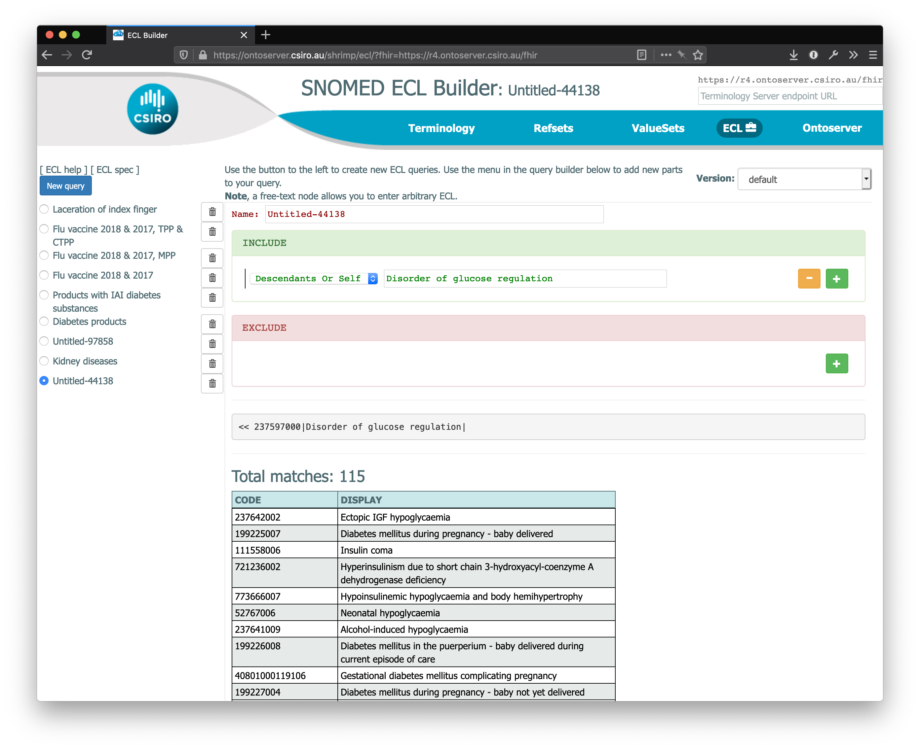

Slide 21
Disorder of glucose regulation ValueSet
{
"resourceType": "ValueSet",
"compose": {
"include": [
{
"system": "http://snomed.info/sct",
"filter": [
{
"property": ”concept",
"op": "is-a",
"value": "237597000"
}
]
}
]
}
}

Slide 22
Disorder of glucose regulation ValueSet
{
"resourceType": "ValueSet",
"compose": {
"include": [
{
"system": "http://snomed.info/sct",
"filter": [
{
"property": "constraint",
"op": "=",
"value": "<< 237597000|Disorder of glucose regulation|"
}
]
}
]
}
}

Slide 23
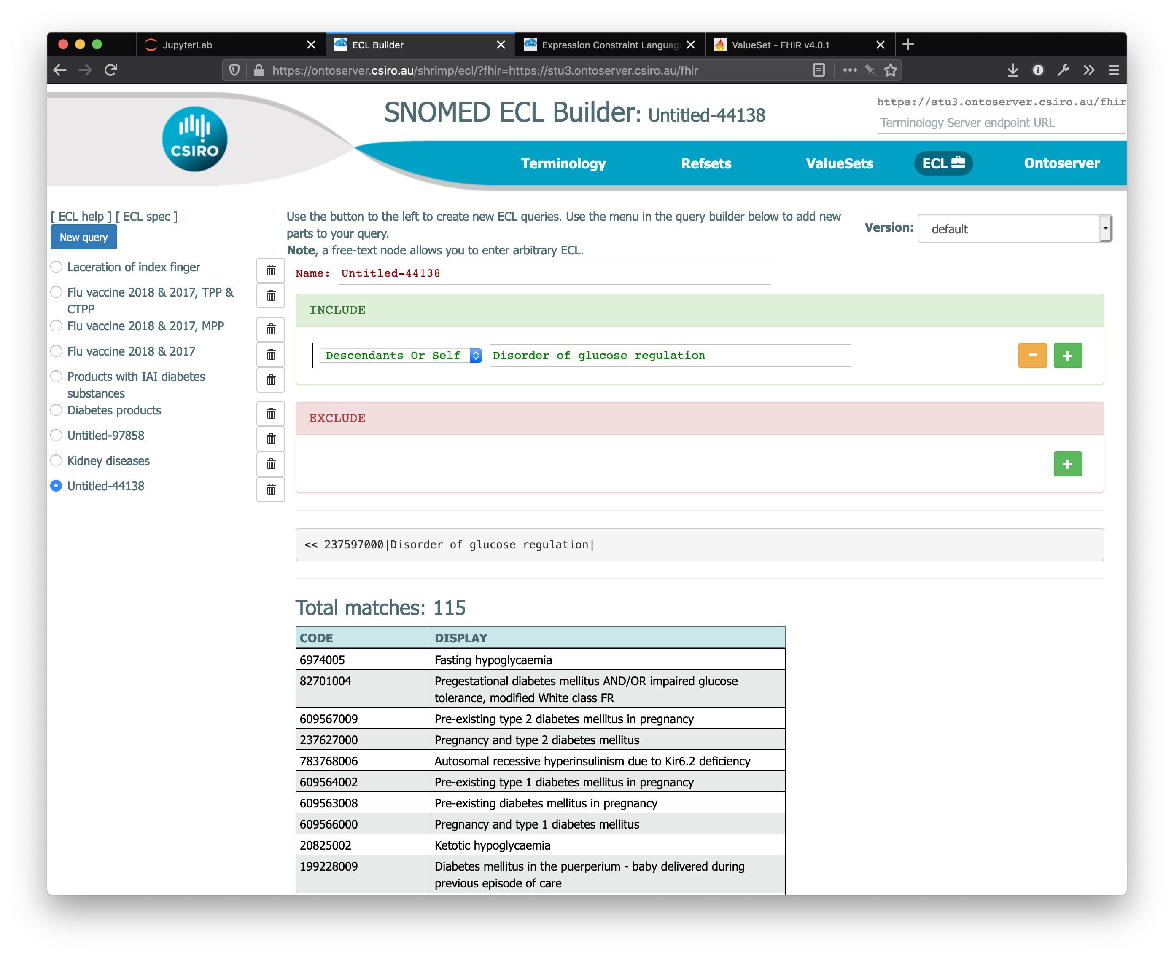

Slide 24
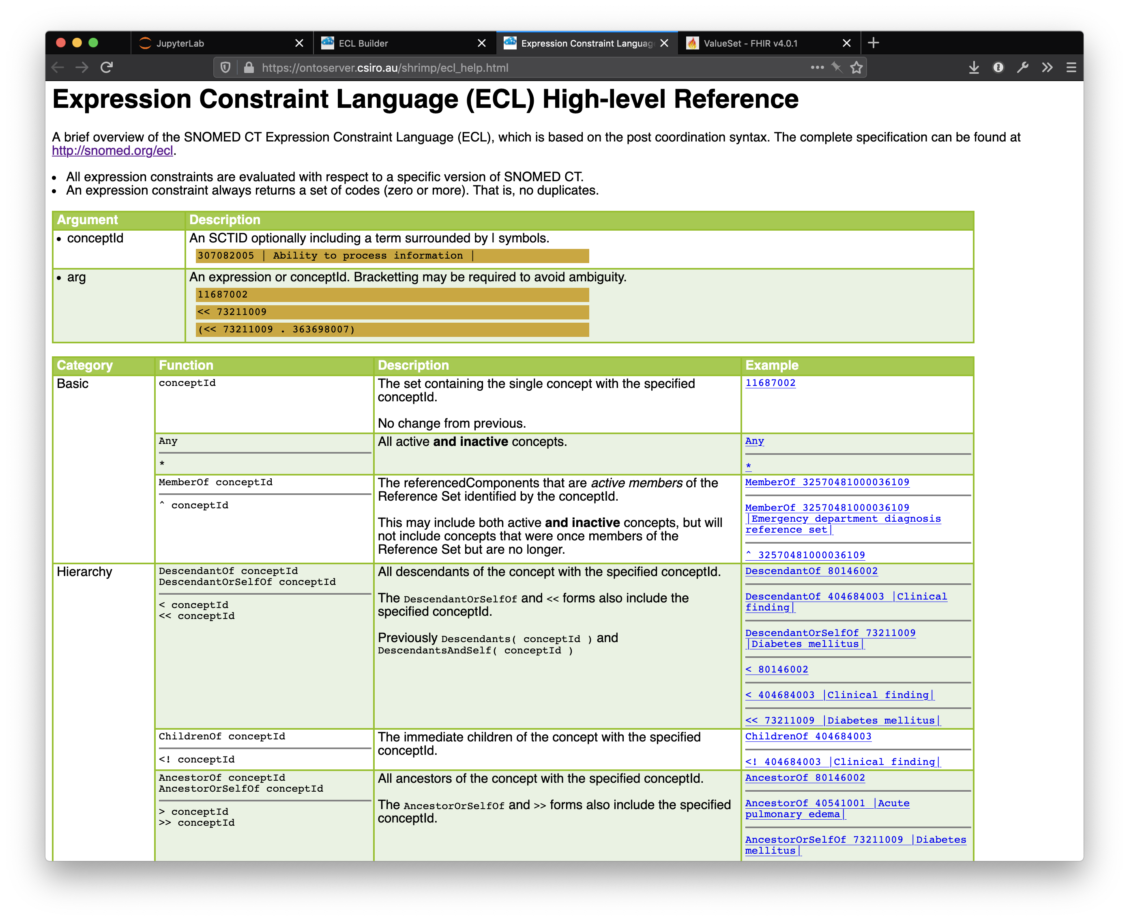

Slide 25
Loading the expansion into Spark
import json
from pyspark.sql import Row
tx_conn.request('POST', '/fhir/ValueSet/$expand', json.dumps(valueset), headers=headers)
response = tx_conn.getresponse()
json_string = response.read()
parsed = json.loads(json_string)
codes = [Row(system=x['system'], code=x['code']) for x in parsed['expansion']['contains']]
valueset_codes = spark.createDataFrame(codes, ['code', 'system'])

Slide 26
ValueSet membership query
conditions_dataset.join(valueset_codes,
(conditions_dataset.conditionCoding.system == valueset_codes.system) &
(conditions_dataset.conditionCoding.code == valueset_codes.code),
'left_outer') \
.select(conditions_dataset.id,
valueset_codes.code.isNotNull().alias(In value set?'))

Slide 27
Test the grouping on the data
Why doesn’t “Disorder of glucose regulation” include “Prediabetes”?

Slide 28
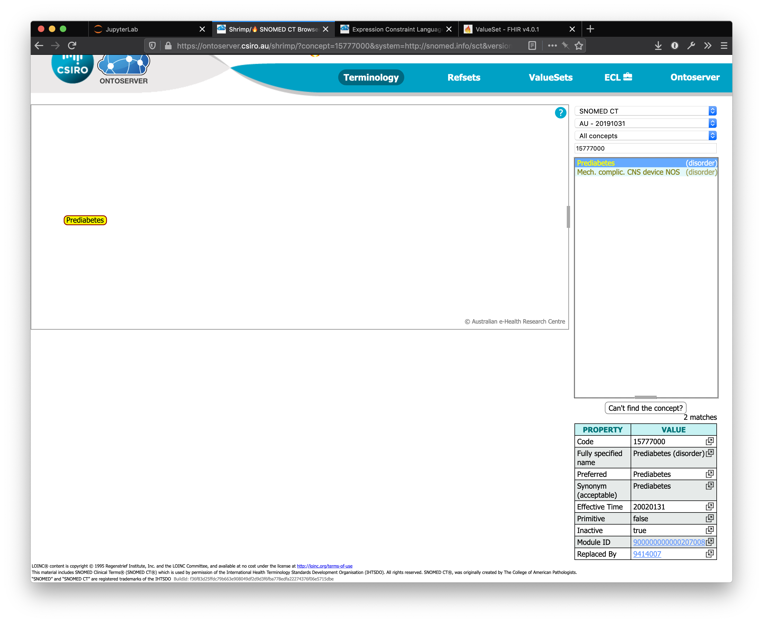

Slide 29
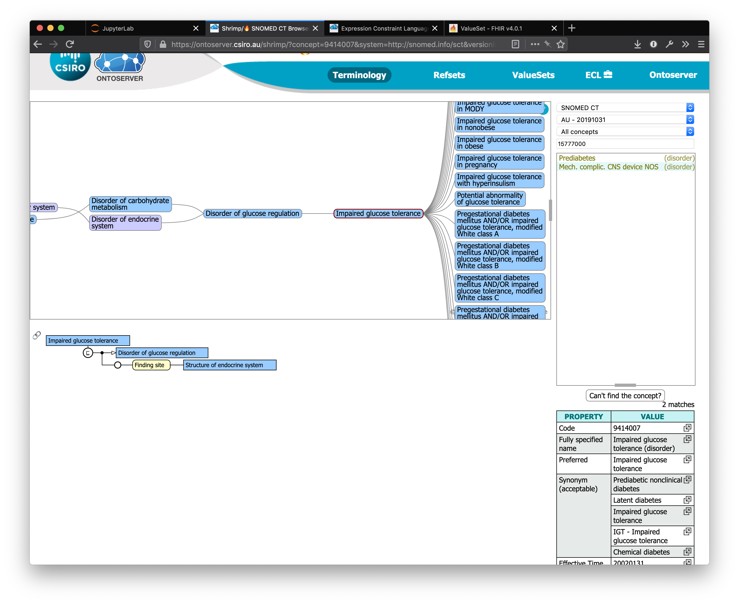

Slide 30
Historically coded data
Real data (and synthetic data!) often contains codes that were active at the time of capture, but have since been retired
SNOMED CT includes relationships between retired codes and the codes they were replaced by
We can query this information through the FHIR API

Slide 31
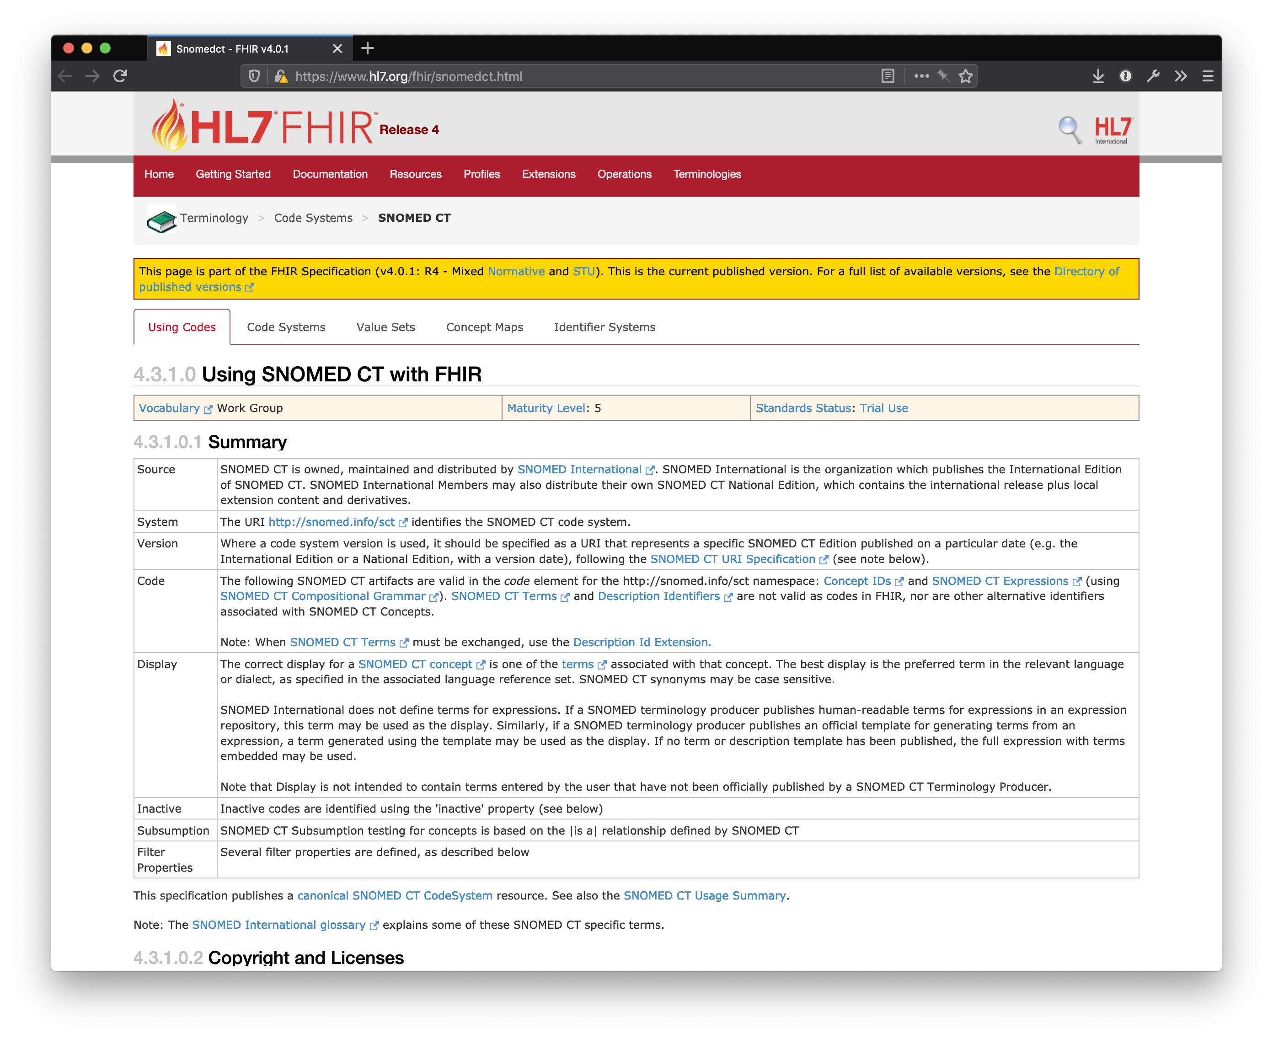

Slide 32
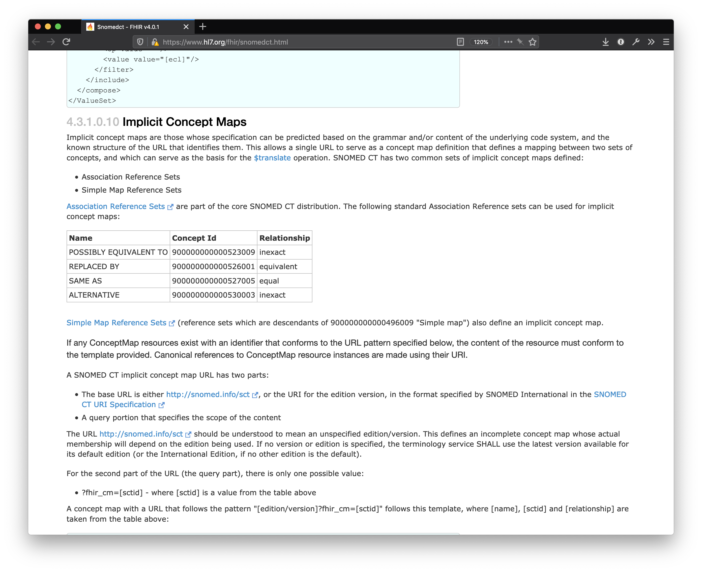

Slide 33
Translate request over implicit ConceptMap
{
"resourceType": "Parameters",
"parameter": [
{
"name": "url",
"valueUri": "http://snomed.info/sct?fhir_cm=900000000000526001"
},
{
"name": "system",
"valueUri": "http://snomed.info/sct"
},
{
"name": "code",
"valueCode": "9414007"
},
{
"name": "reverse",
"valueBoolean": true
}
]
}
REPLACED BY

Slide 34
Translate response
{
"resourceType": "Parameters",
"parameter": [
{
"name": "result",
"valueBoolean": true
},
{
"name": "match",
"part": [
{
"name": "equivalence",
"valueCode": "equivalent"
},
{
"name": "concept",
"valueCoding": {
"system": "http://snomed.info/sct",
"code": "15777000",
"display": "Prediabetes"
}
},
{
"name": "source",
"valueString": "http://snomed.info/sct/32506021000036107/version/20191031?fhir_cm=900000000000526001"
}
]
}, ...
]
}

Slide 35
ValueSet including historical codes
{
"resourceType": "ValueSet",
"compose": {
"include": [
{
"system": "http://snomed.info/sct",
"filter": [
{
"property": ”concept",
"op": "is-a",
"value": "237597000"
}
]
},
{
"system": "http://snomed.info/sct",
"concept": [
{ "code": "15777000" }, ...
]
}
]
}
}

Slide 36
Questions?

Slide 37



www.devdays.com

